Slide 1


Midterm Presentation
Team: 5G

Slide 2

List
table of contents
1
Introduction
2
Architecture
3
Web design
4
Dataset
5
Model & Experiments
ⓒSaebyeol Yu. Saebyeol’s PowerPoint

Slide 3


Part 1
Introduction
ⓒSaebyeol Yu. Saebyeol’s PowerPoint

Slide 4
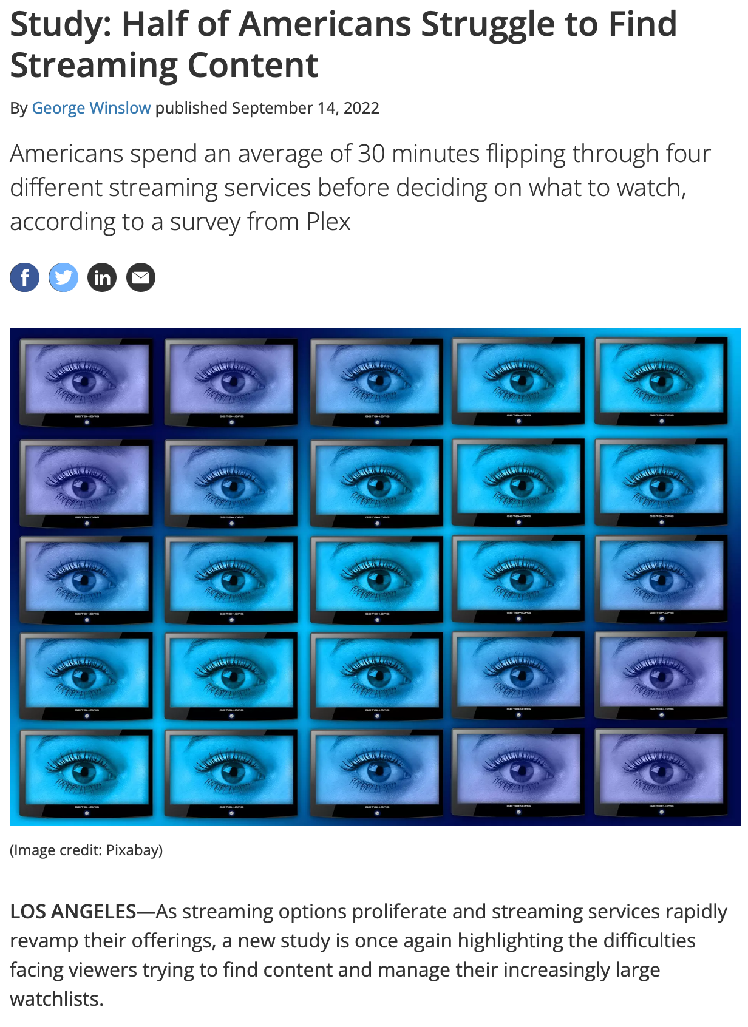
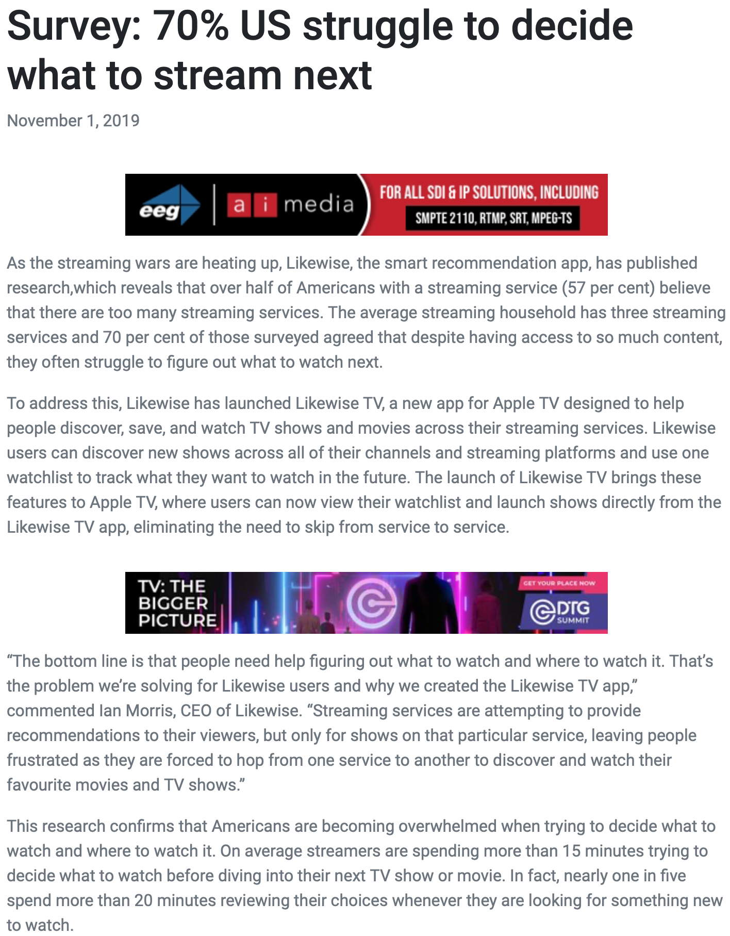
Part 1,
Background
Notes:
These days, lots of platforms use state of art AI recommendation systems. However, there are still some problems using such AI recommendation systems so we need to provide more better, integrated service to customers.

Slide 5
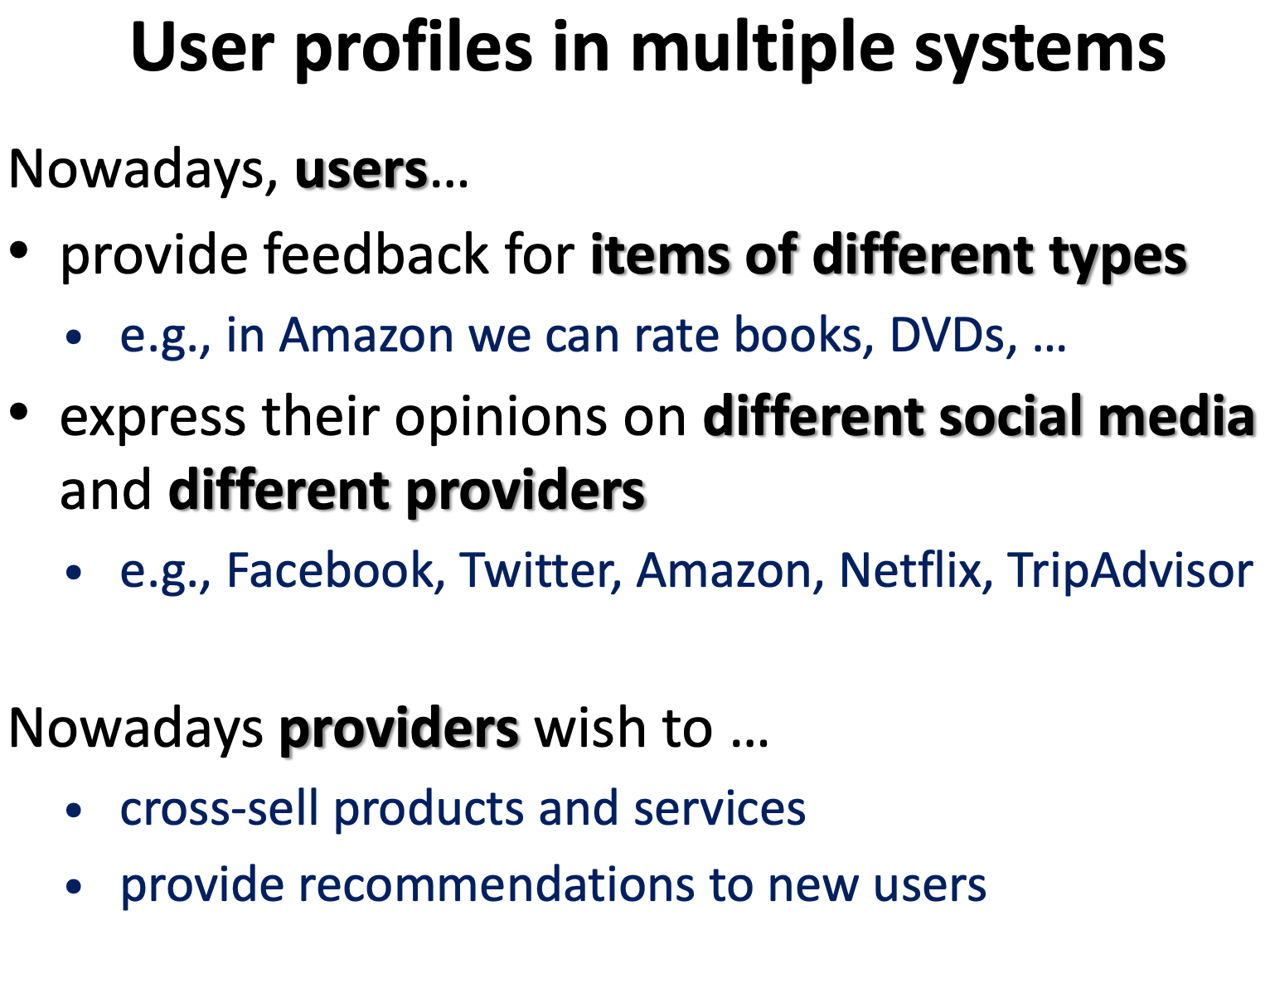
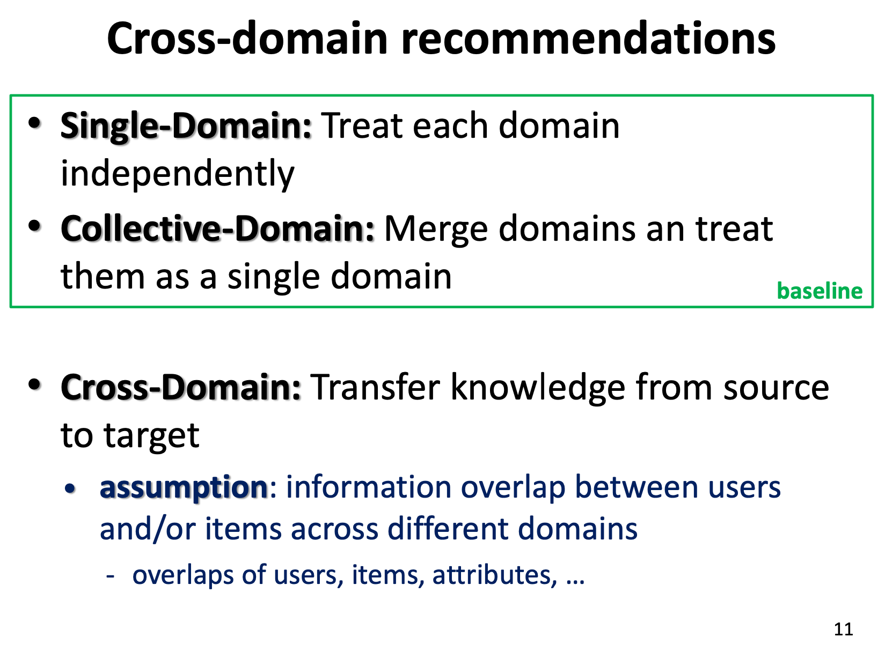
Part 1,
Background
Cross-Domain Recommendations(CDR)
Cited from "8th ACM Conference on Recommender Systems - Cross-Domain Recommender Systems (Iván Cantador, Paolo Cremonesi)"
Notes:
So we decided to make Cross-Domain Recommendations, which refers to using data of multiple domain such as movies, dramas, webtoons to provide integrated recommendation service for each users.

Slide 6
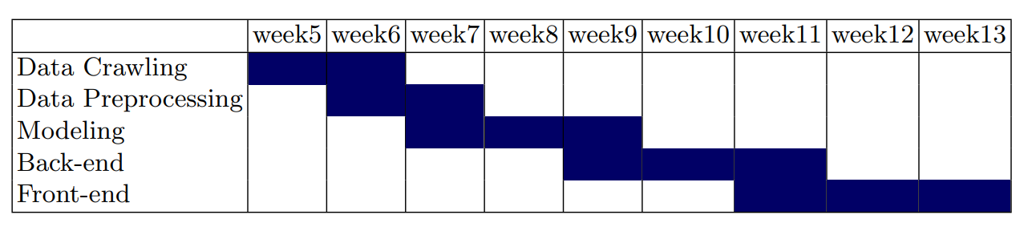
Part 2
Data analysis
Progress schedule

Slide 7
Part 1
Role of member
이지형
✨Leader✨
Server to DB connection
금찬후
Build DB
Schema Design
남인서
Creating a Web Screen
홍진화
Implement web function
Function design
홍서윤
Model learning and experimentation
Model and Server Interworking

Slide 8

Part 2
Architecture
ⓒSaebyeol Yu. Saebyeol’s PowerPoint

Slide 9





Part 2,
Architecture
drama
webtoon
movie
User data
Recommended item
Register & information
User data
Recommended item
User data
Notes:
A schematic diagram of the overall process. First, we recommend contents based through drama, webtoon, and movie datasets. After that, when the user provides information through registration and use, the collaborative filtering model is also used based on this. Finally, we plan to provide the items recommended by the two models in proportion to the information provided by the user.

Slide 10
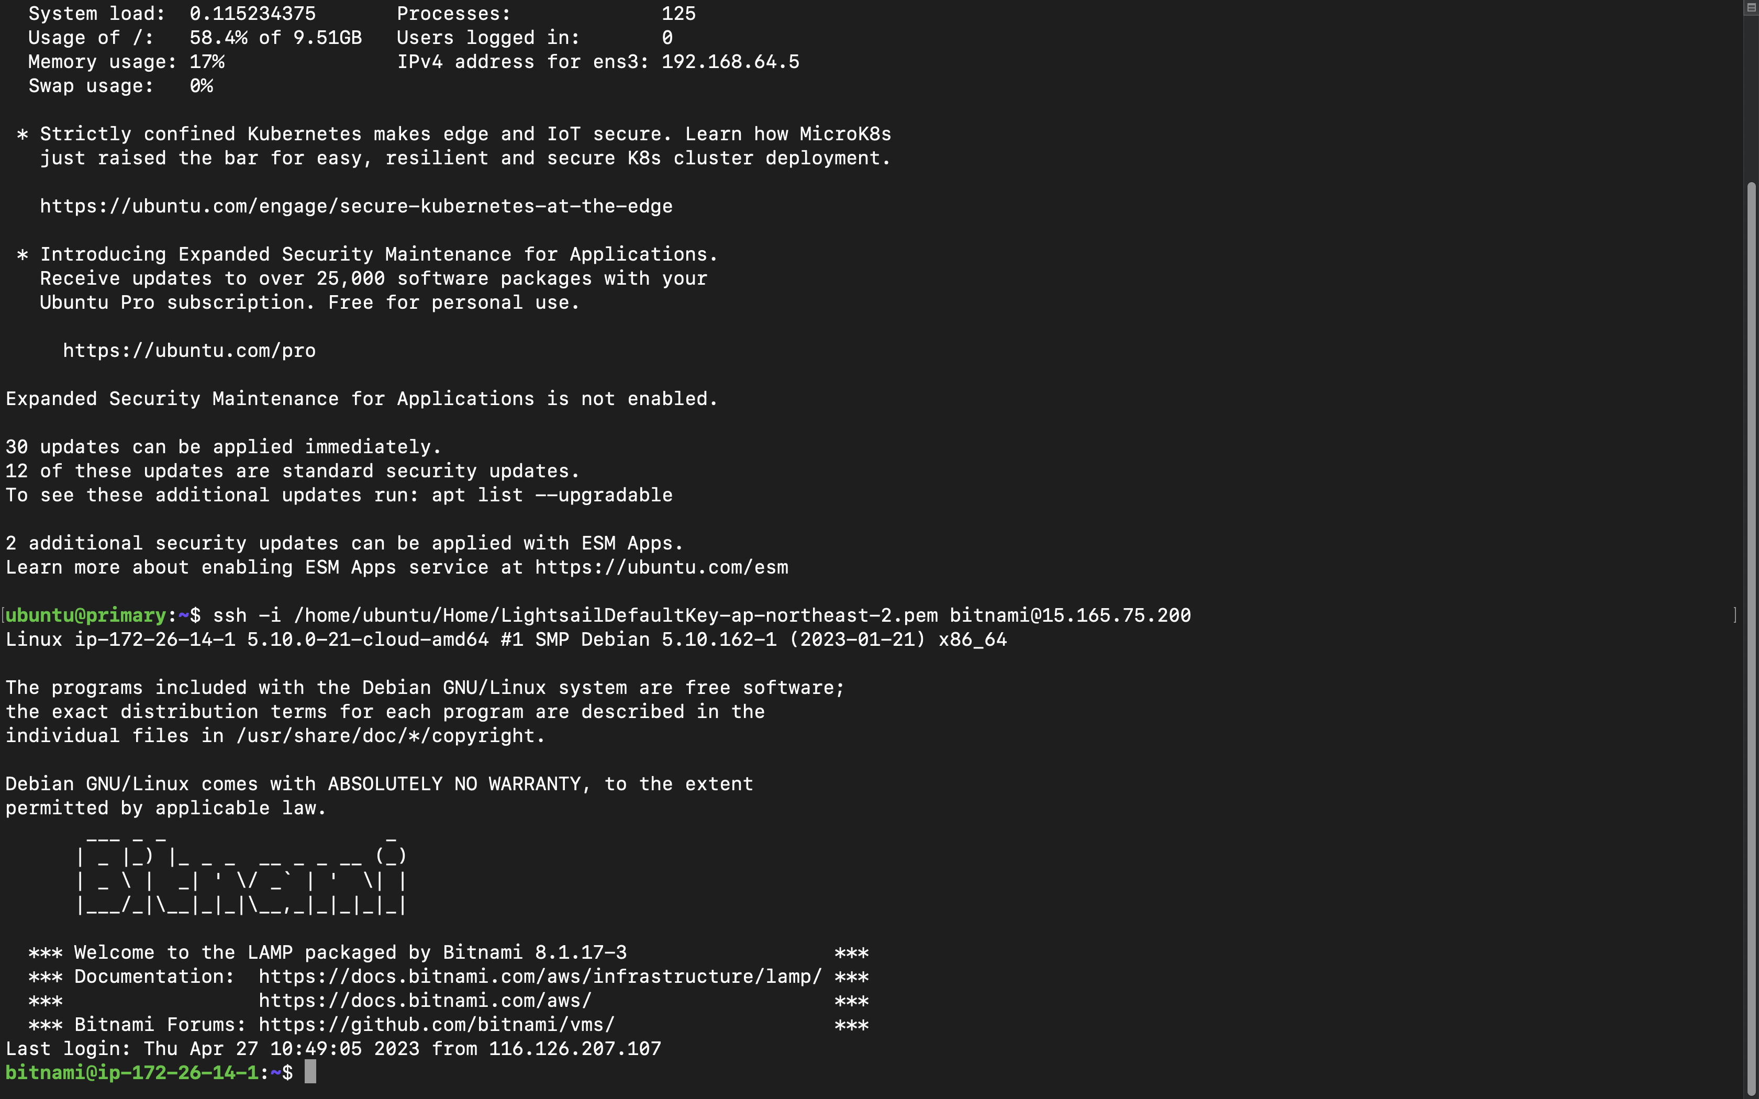


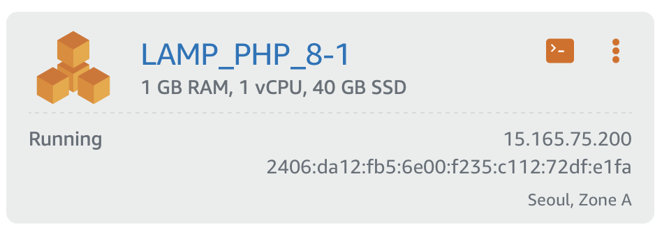
Part 3
Database
Notes:
We managed to construct a database in the server. We used amazon lightshail, provided by the amazon web service(aws), to create server instance called LAMP(PHP 8). This instance includes MariaDB, which is basically same as MySQL, and phpMyAdmin and so on.

Slide 11
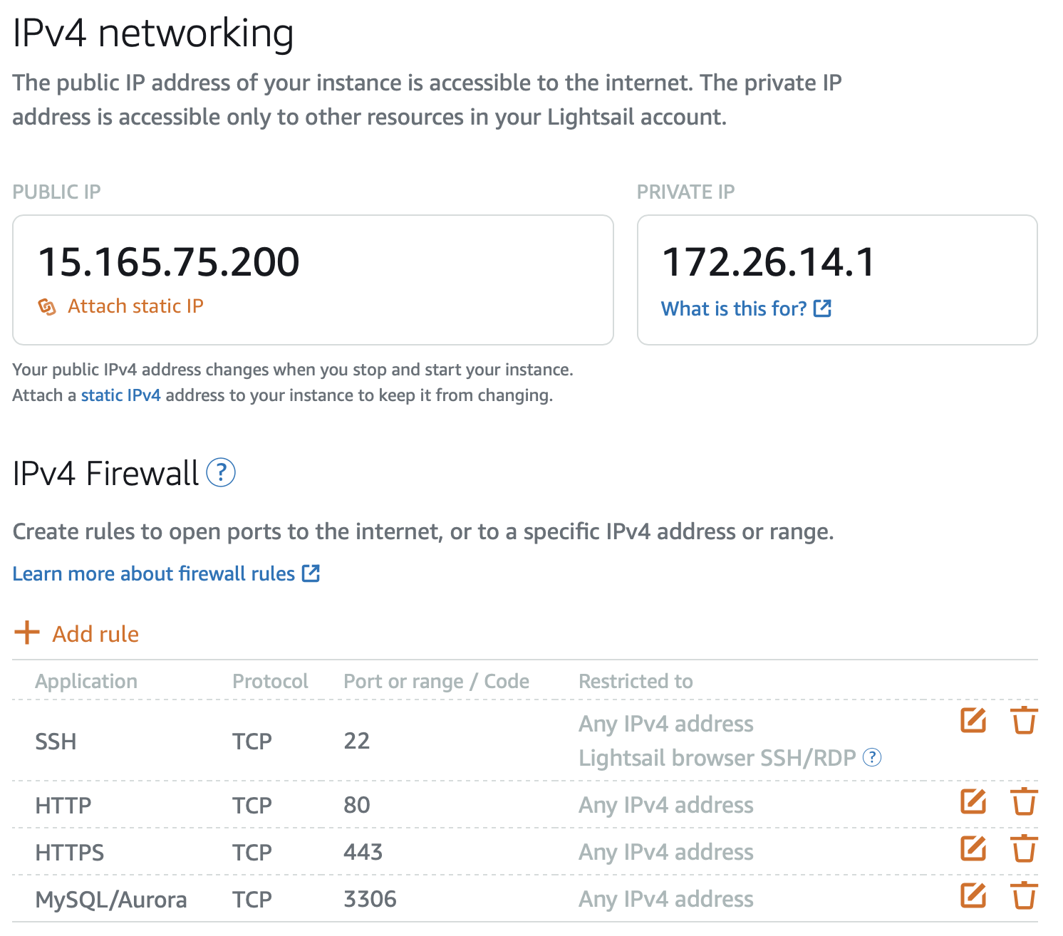
Part 3
Database
Notes:
We added network rules on this instance to open ports for using MySQL(port=3306), so that we can remotely connect MySQL server from other sources.

Slide 12

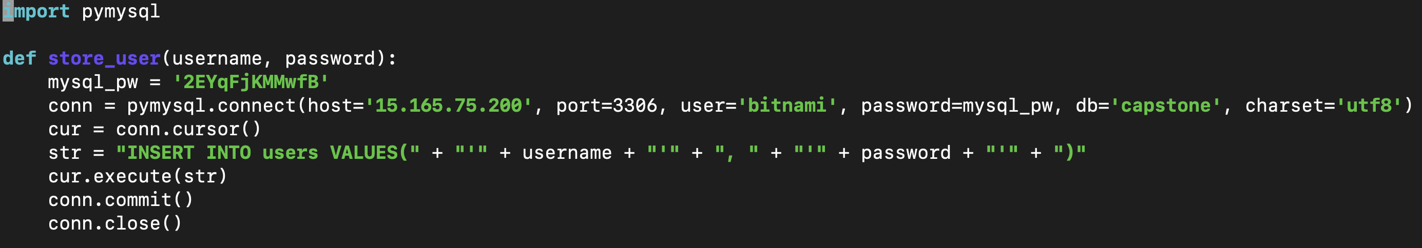
Part 3
Database
Notes:
When using python script for backend side jobs, we use PyMySQL module and make connect cursor to connect to MySQL server. (When generating the cursor, Server-IP address, port number, user name, and a password for mysql server are required.) This is a test code for inserting username and password to the MYSQL server remotely.

Slide 13
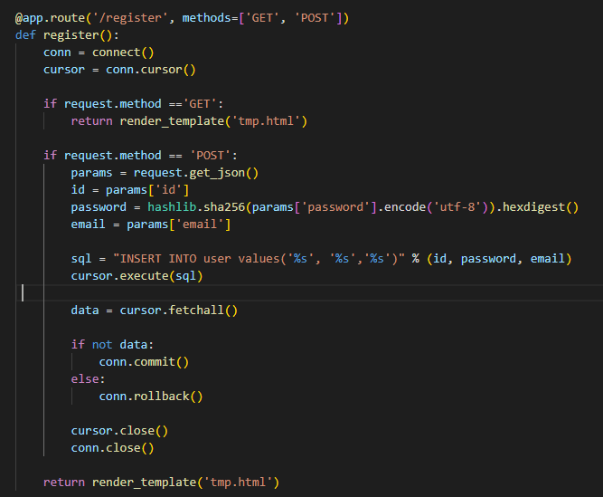

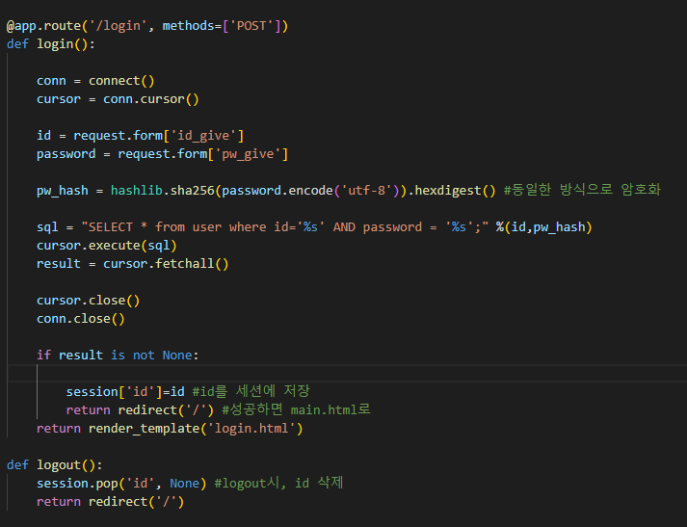
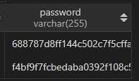
Part 3
Flask

Slide 14
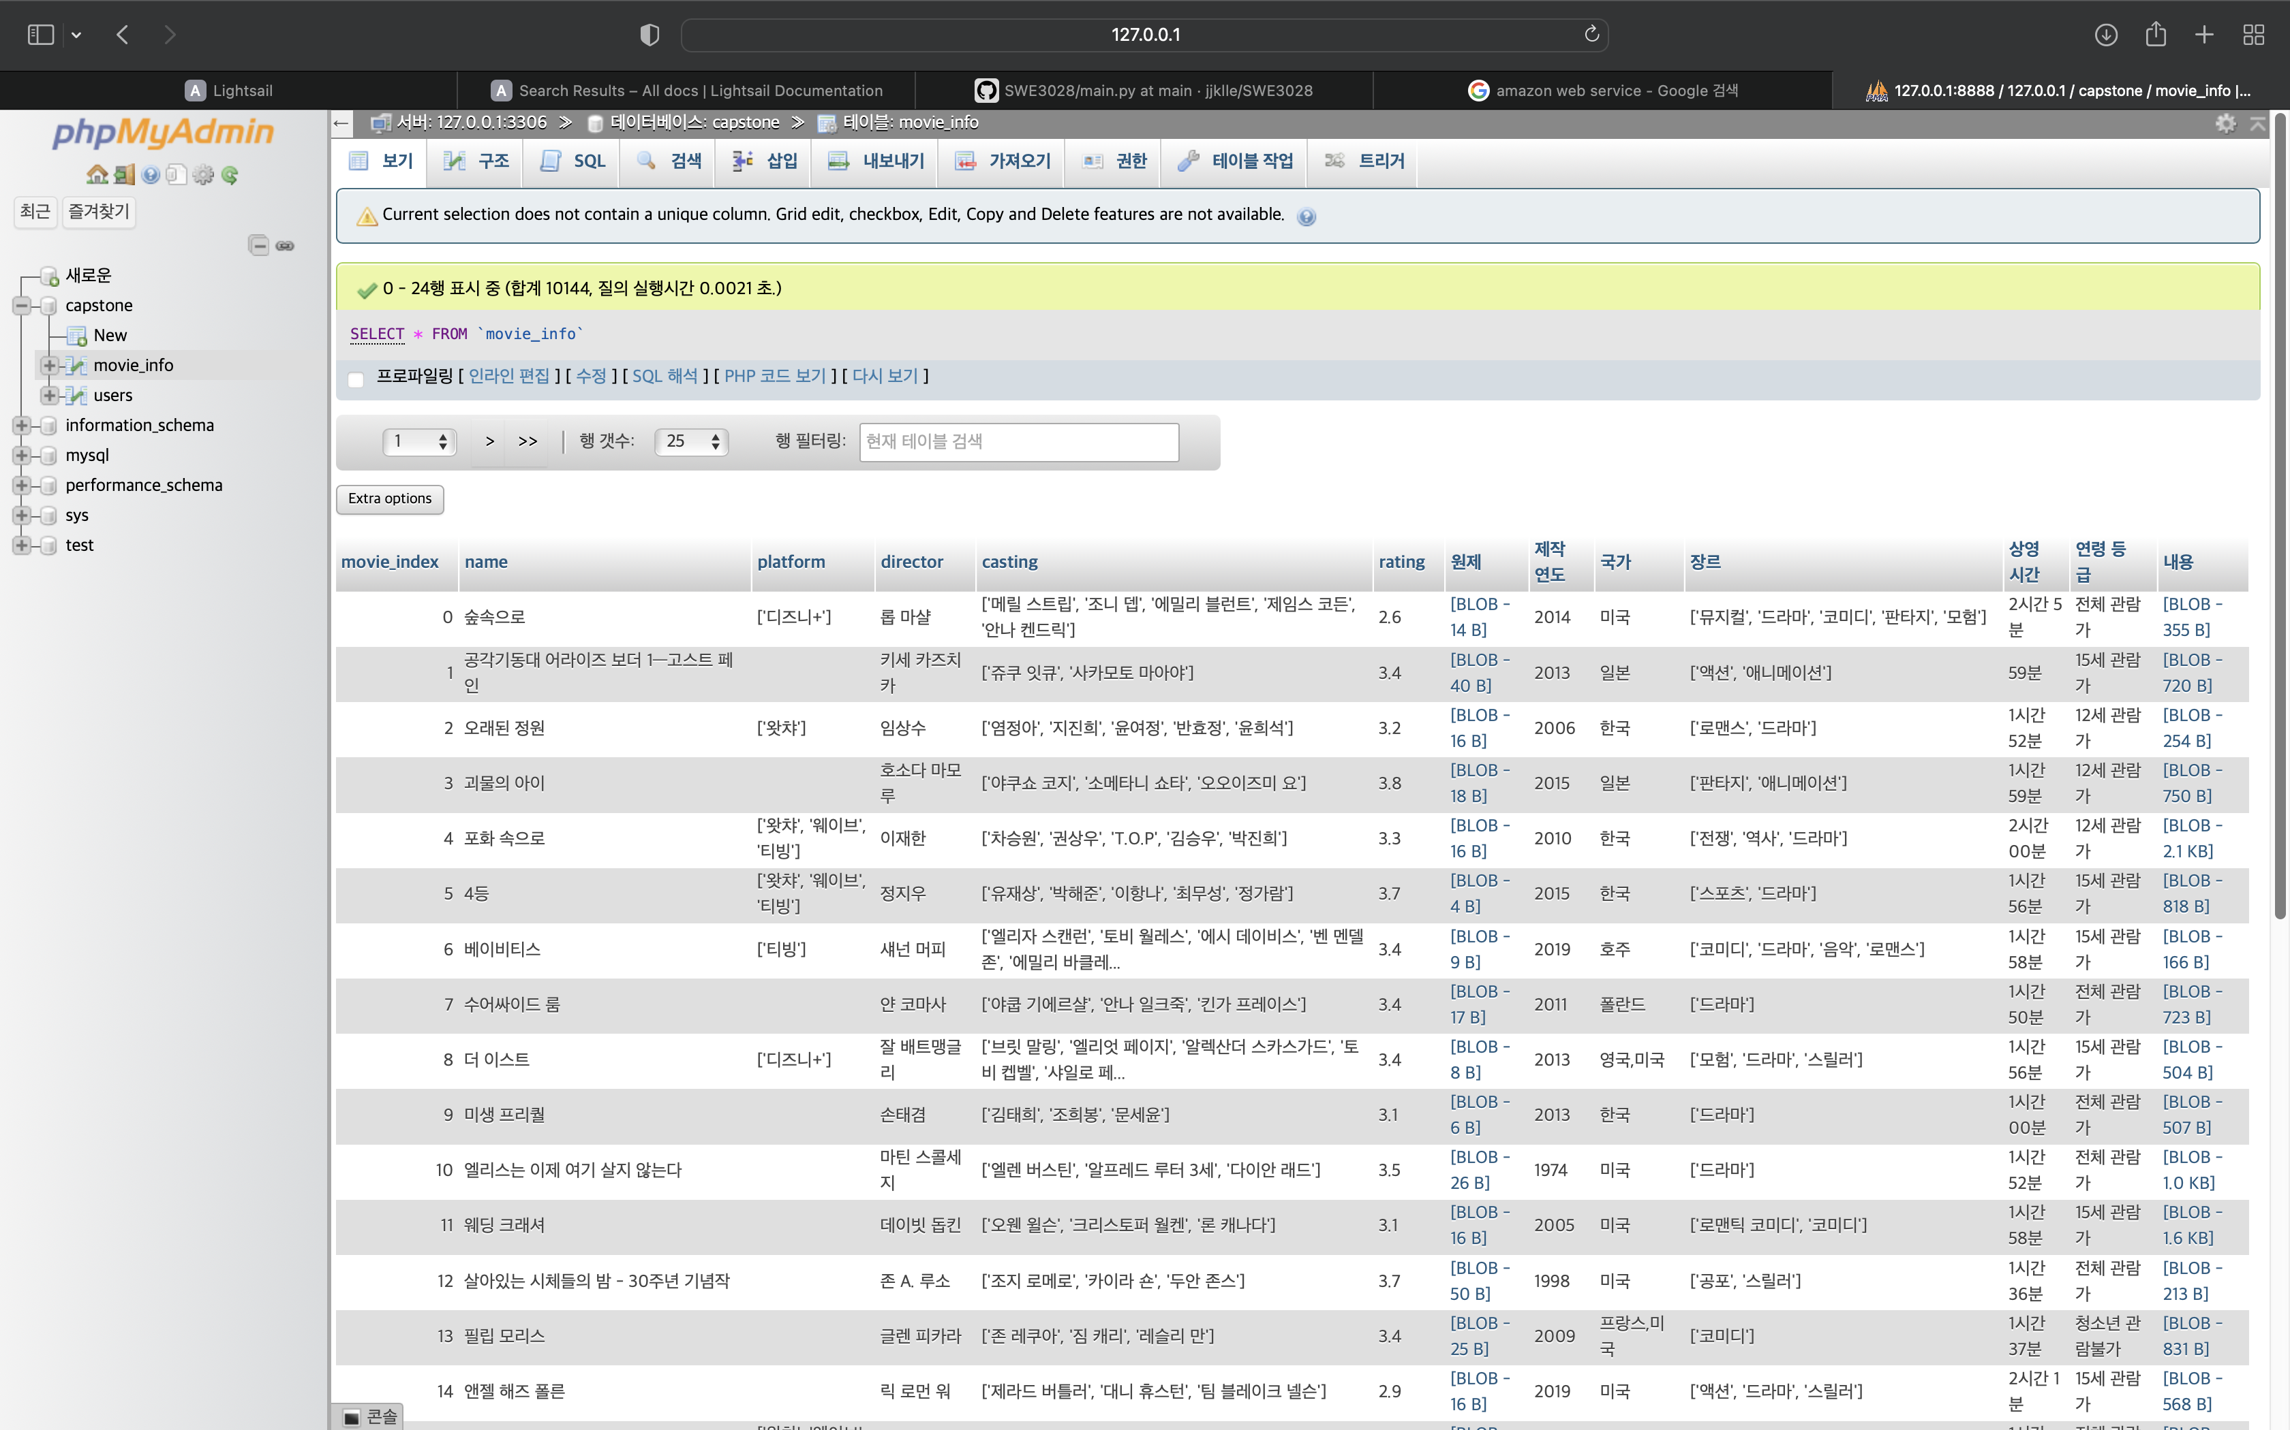

Part 3
Database
movie_info.csv -> table in MySQL server database
Notes:
Other than user information, we also created database for contents such as movie data. When handling databases, tables, and schemas in MySQL, we use web based software called phpMyAdmin, which is offered from the Lightshail instance we previously mentioned, rather than SQL script because it is more easy to use. (For example, we can easily create table and insert large movie_info data in csv format, using this phpMyAdmin GUI.)

Slide 15
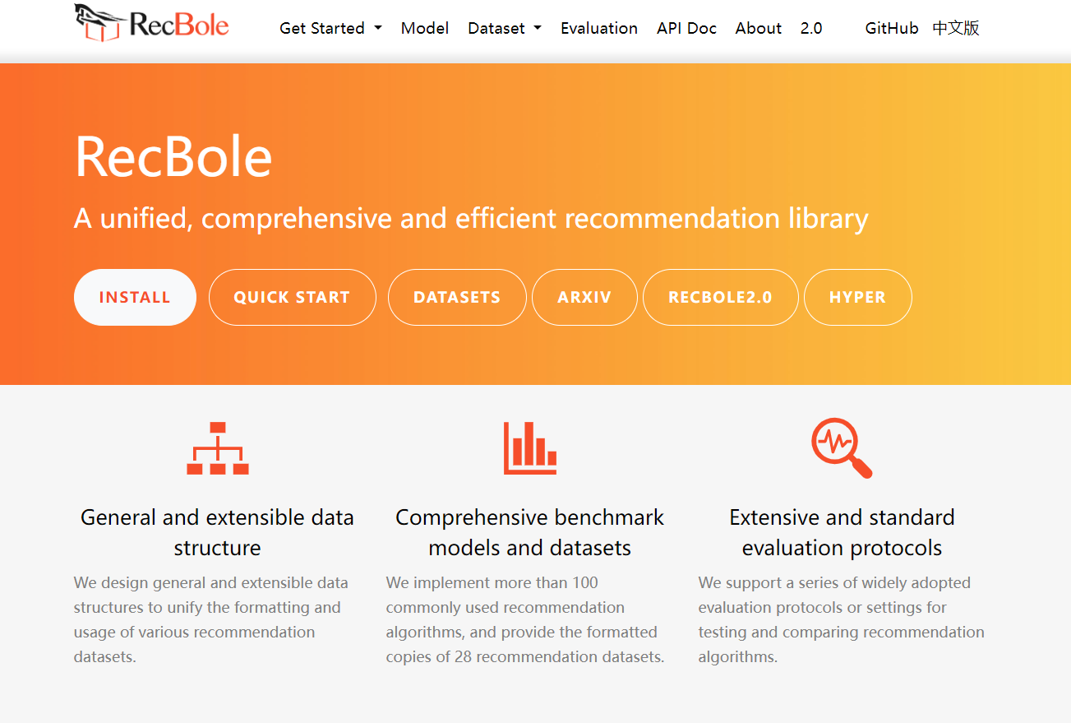
Part 2
Recbole
Notes:
We used a framework called recbole for model training and item recommendation prediction. The experiments and training were conducted outside of the server, and the trained models were uploaded to the server for prediction. Since training on the server can cause resource and time issues, we modified the framework code to enable only inferencing on the server using the trained model.

Slide 16
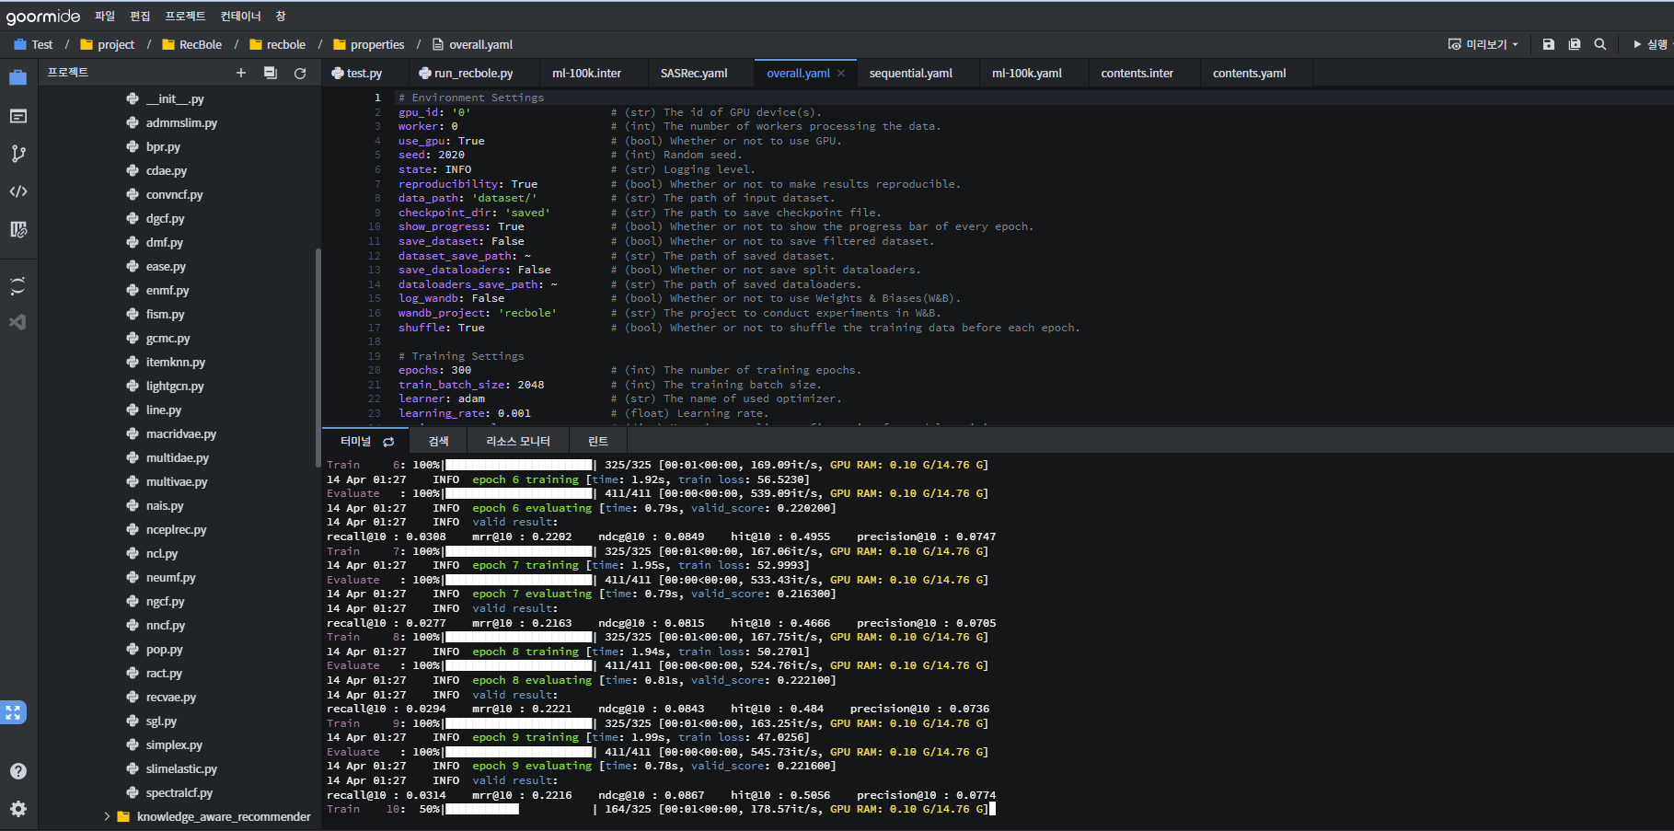
Part 2
Goorm ide
Notes:
The experimental environment needed a linux server, so we used a goorm server.

Slide 17
Part 3
Web design
ⓒSaebyeol Yu. Saebyeol’s PowerPoint

Slide 18

Part 2
Web page
Free Template reference: https://templatemo.com/tm-525-the-town
Notes:
This is the main page of the service. We used a web template to create a webpage. So far, We have finished implementing the login, signup, and content display in the frontend.

Slide 19
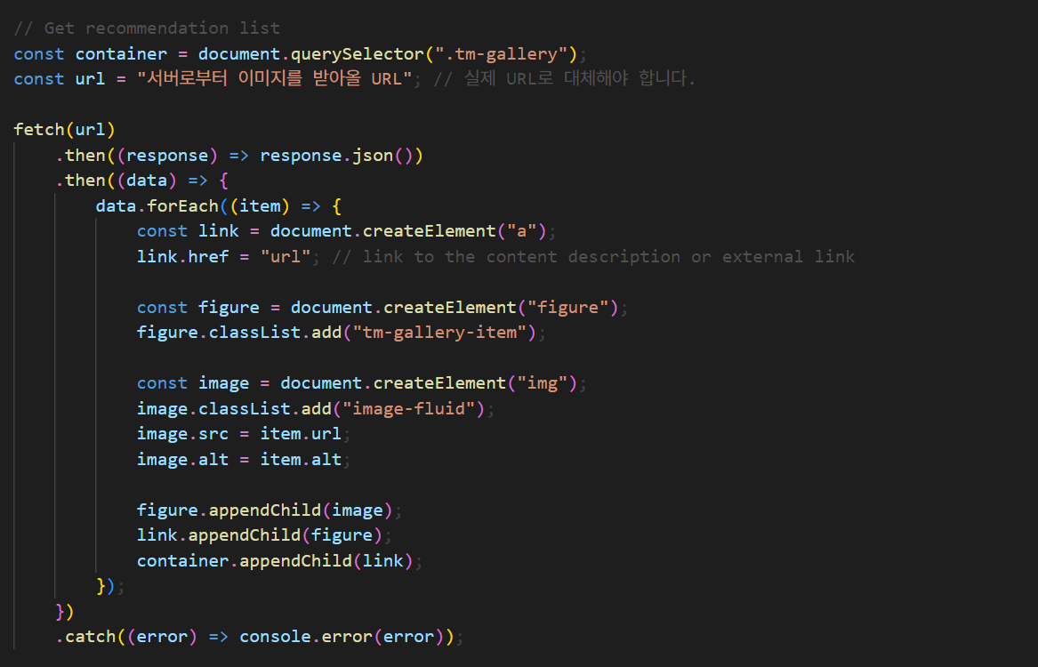
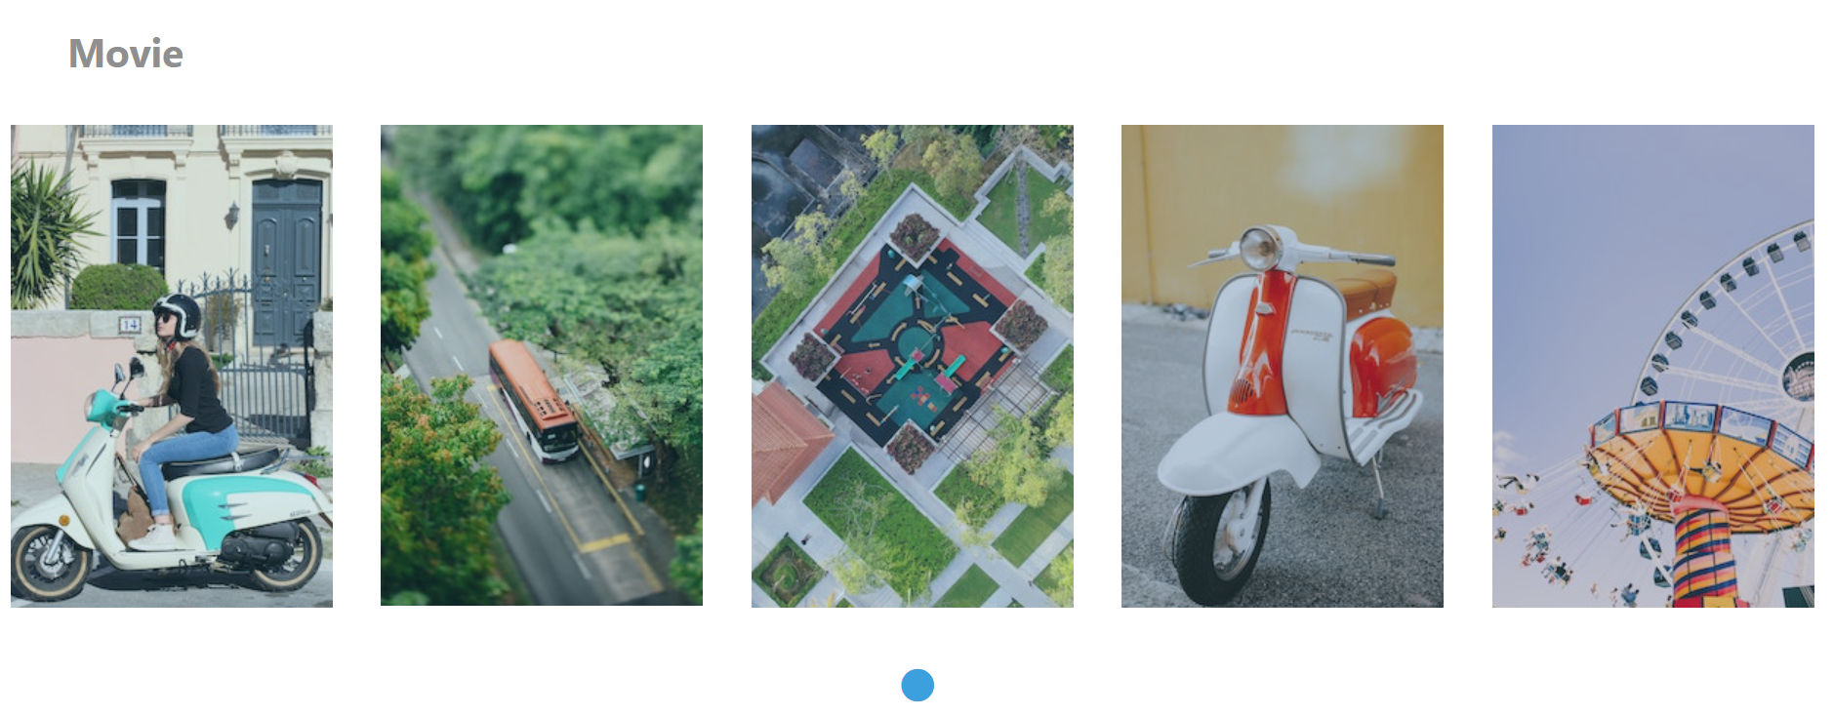
Part 2
Web page
Notes:
This is the content display page. Users can see a recommended content list for each domain-movies, dramas, and webtoons. The database is not yet complete, so we have written simple code to connect to the server.

Slide 20
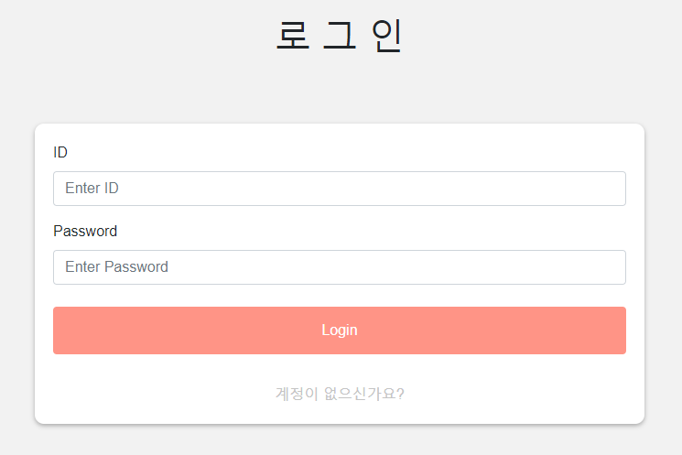
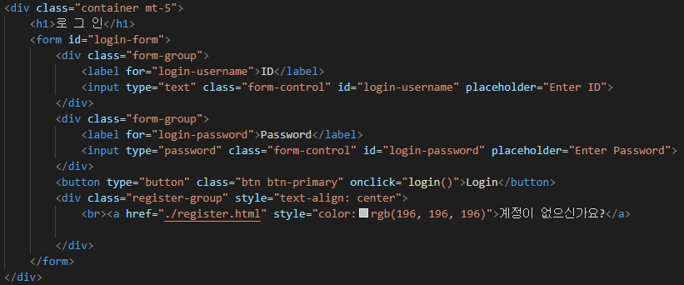
Part 2
Login Page UI
Notes:
This is the login page.

Slide 21
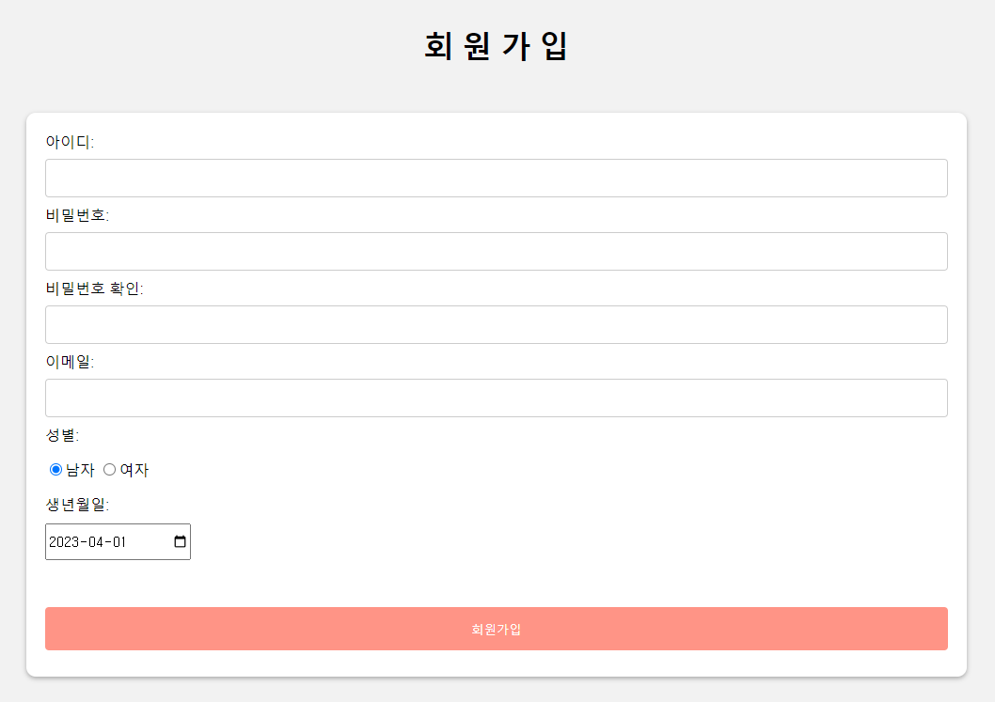
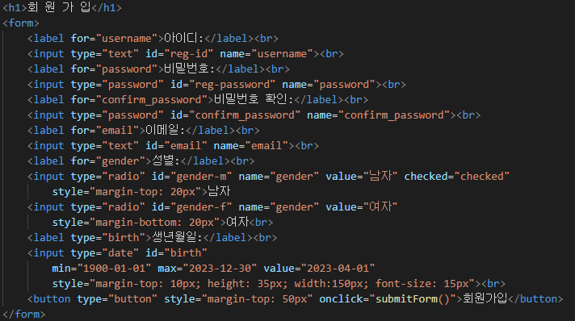
Part 2
Register Page UI
Notes:
This is the registeration page. We need a function to receive information about users' preferred content during sign-up. We plan to implement a page where users can enter ratings for several works when they enter this information on the page.

Slide 22




Part 2
Limitation
Choose all the contents that you like (3/5)
Notes:
This is the registeration page. We need a function to receive information about users' preferred content during sign-up. We plan to implement a page where users can enter ratings for several works when they enter this information on the page.

Slide 23


Part 4
Dataset
ⓒSaebyeol Yu. Saebyeol’s PowerPoint

Slide 24



Part 2
3 Domains' Data
Korea drama dataset
Korea webtoon dataset
Popular movie dataset
Notes:
There are three types of data that our team used in this project. We use Korean dramas, webtoons, and movie datasets.

Slide 25
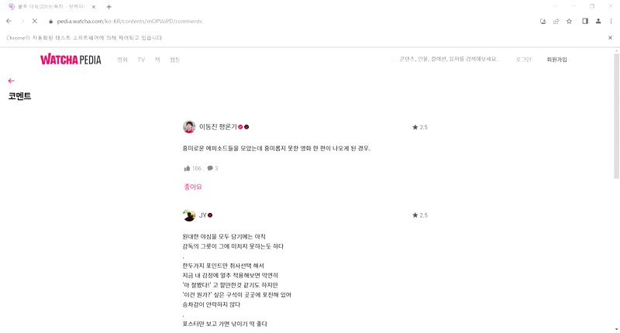


Part 2
Data Crawling
Notes:
Each dataset was collected by crawling data scattered across each Internet domain. In this process, we used beautiful soup and selenium. Beautifulsoup is used for static crawling and selenium is used for dynamic crawling.

Slide 26



Part 2
Data Information
Movie
Drama
Webtoon
Watchapedia
Watchapedia
Watchapedia
Title
Genre
Director
Plot summary
...
Title
Genre
Author
Description
...
Title
Genre
Country
Director
Description
...
Notes:
The websites extracted for each data are as follows. The extracted data is saved in the form of a csv file, and the columns include title, genre, and country. The initial plan was to get the necessary information from different websites, but there was a limitation that the CF model could only be applied if the same user saw it, so we crawled the information only in watchapidia to unify the user.

Slide 27
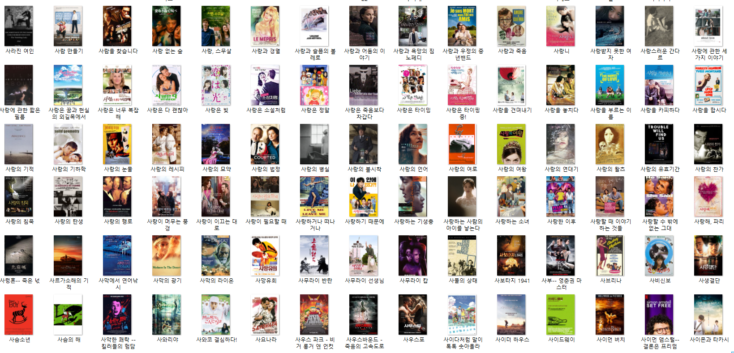
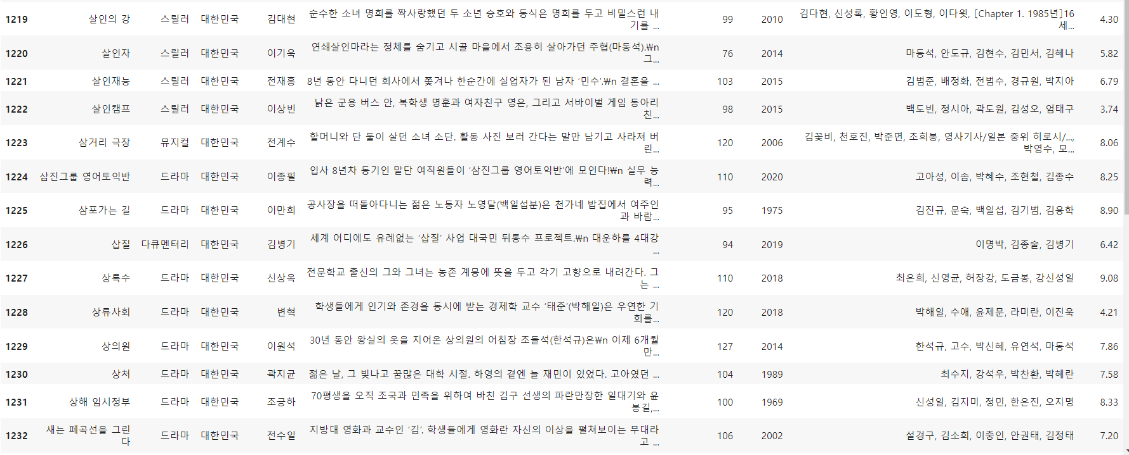
Part 1
Data Crawling
Notes:
In addition to the csv file we mentioned earlier, we crawled the photo file corresponding to each content. This is to show pictures of the content when recommending content, and to use it for researching preferred content when signing up for membership. It will be easier for the user to check if the title and picture are displayed together during the survey.

Slide 28
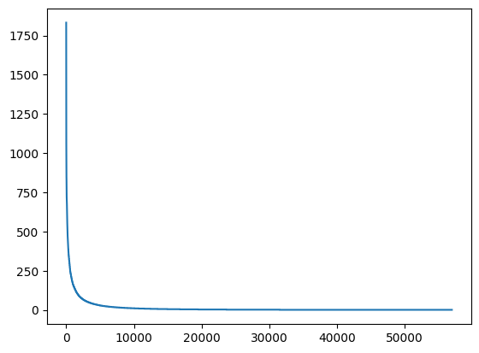
Part 2
Data analysis
Contents ratings
Rating counts
It shows a very biased graph.
The content that received the most evaluation was rated 1832 times.
and that content is “기생충”
The content that received the least evaluation was evaluated once.
Item id
Notes:
The following graph shows how many ratings each item_id has received. As you can see, it has a highly biased shape, which means that certain items are watched much more frequently. The most watched content is "Parasite.“.

Slide 29
Part 2
Legnth filtering
Description | Value
The number of users | 2887
Average actions of users | 286.82
The number of items | 56965
Average actions of items | 14.53
The number of inters | 827767
The sparsity of the dataset | 99.4%
Description | Value
The number of users | 2866
Average actions of users | 252.57
The number of items | 10742
Average actions of items | 367.37
The number of inters | 723629
The sparsity of the dataset | 97.6%
Over 10 click user
Notes:
There is a problem that too high sparsity reduces recommended performance. To address this issue, we decided to filter out items that had been clicked less than 10 times. As a result, the total number of item types decreased significantly and sparsity also decreased significantly.

Slide 30
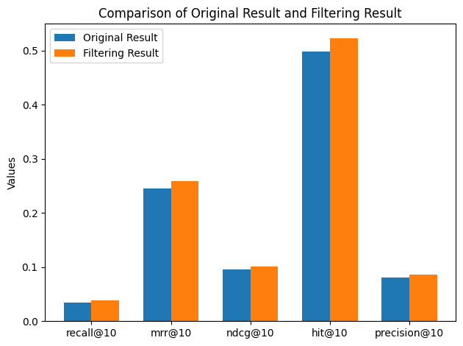
Part 4
evaluation
The results after filtering show higher performance.
We can check that method works properly
Notes:
All performance indicators perform better when we use this data at learning. Therefore, we decided to use this filtering method for all model learning.

Slide 31
Part 5
Model & Experiments
ⓒSaebyeol Yu. Saebyeol’s PowerPoint

Slide 32
Part 4
Models
Model name | category | target
BERT | Word embedding | Title, category, description
BPR(MF) | Collaborative Filtering model | User-item interaction
ItemKNN | Collaborative Filtering model | User-item interaction
NeuMF | Collaborative Filtering model | User-item interaction
MultVAE | Collaborative Filtering model | User-item interaction
Notes:
The following is the model used by our team. Our team is utilizing both a contents-based model and a collaborative-based model for recommendation. We are using Bert as our contents-based model we change the title and category into embeddings to calculate similarity. For the CF model, we selected BPR, ItemKNN, NeuMF, and MultVAE and conducted performance evaluations for each model.

Slide 33
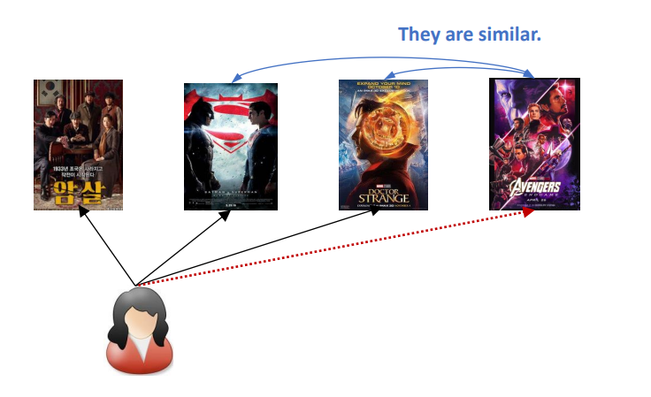
Part 4
Contents based Model
Content-based filtering uses item features to recommend other items similar to what the user likes, based on their previous actions or explicit feedback.
Notes:
A contents-based model is a method of recommending items to users by utilizing the similarity between contents. Typically, a method of creating a single embedding vector for each item is used, and item2vec model is representative. This approach is similar to creating word embeddings by considering the position of words.

Slide 34
Part 4
Contents based Model architecture
Drama Title
Title Embedding
Drama Genre
Genre Embedding
Pretrained Model
BERT
Webtoon Title
Title Embedding
Webtoon Genre
Genre Embedding
Movie Title
Title Embedding
Movie Genre
Genre Embedding
Notes:
We utilized Bert to create item embeddings. Bert is a pre-trained language model that has learned an enormous amount of words, and by using it, we can obtain word embeddings. We can use this to obtain embeddings for the title and category of items.

Slide 35
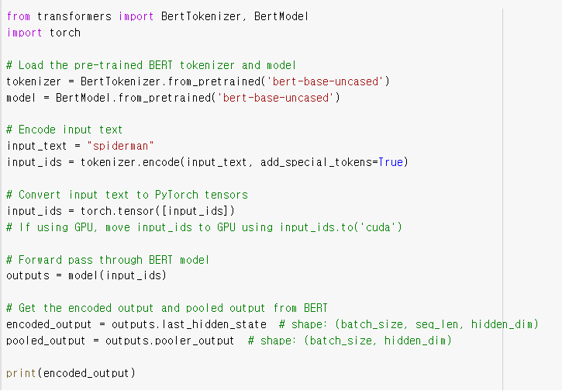
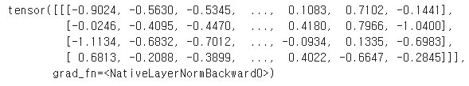
Part 4
Bert word embedding
Make word embedding using BERT
We are plan to make title embedding and category embedding
Notes:
We use collab to actually convert words into embedding vectors. We have not yet proceeded with calculating similarity, but success to convert the title into a 64-dimensional embedding vector.

Slide 36







Part 4
Contents based Model architecture
Calculate the relevance of embedding
Notes:
After the conversion, we recommend topk items with high similarity by calculating the similarity to the content that the user has seen or likes. Since it is a method of utilizing word embedding, even contents in other domains will work effectively. For example, for users who like The Glory, we recommend Taken, a similar genre of movie.

Slide 37
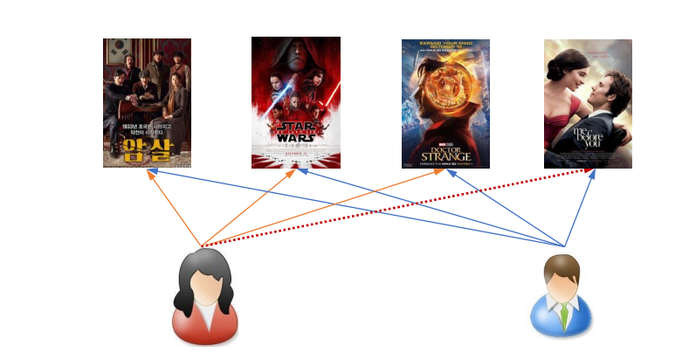
Part 4
Collaborative Filtering Model
collaborative filtering uses similarities between users and items simultaneously to provide recommendations.
Notes:
Collaborative filtering model is a method of recommendation that uses user-item interactions. If two users have seen similar items, they are defined as similar users, and recommendations are made by items that similar users have seen to each other.

Slide 38


Part 4
Contents based Model architecture
Using contents based method to avoid cold start problem
After collecting user’s preference, also using collaborative filtering model to improve the performance of model
Notes:
To solve the cold start problem in the early stages of data, we plan to use the contents-based model when the data is scarce, and then use both contents-based and CF models for recommendations. Additionally, to maximize the efficiency of the CF model, we plan to receive information about the contents and genres that the user has seen when they first sign up.

Slide 39
Part 4
Encoder design
Experiment1
Parameter sharing
drama encoder
webtoon encoder
Movie encoder
Experiment2
Use independent parameters
drama encoder
webtoon encoder
movie encoder
Notes:
We plan to conduct performance experiments on two methods: one applying different encoders for each data and the other applying the same encoder. Currently, we are conducting experiments only with the same encoder.

Slide 40
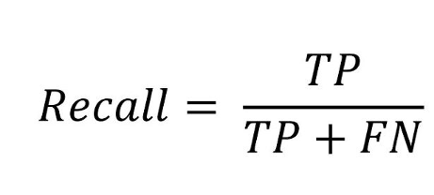
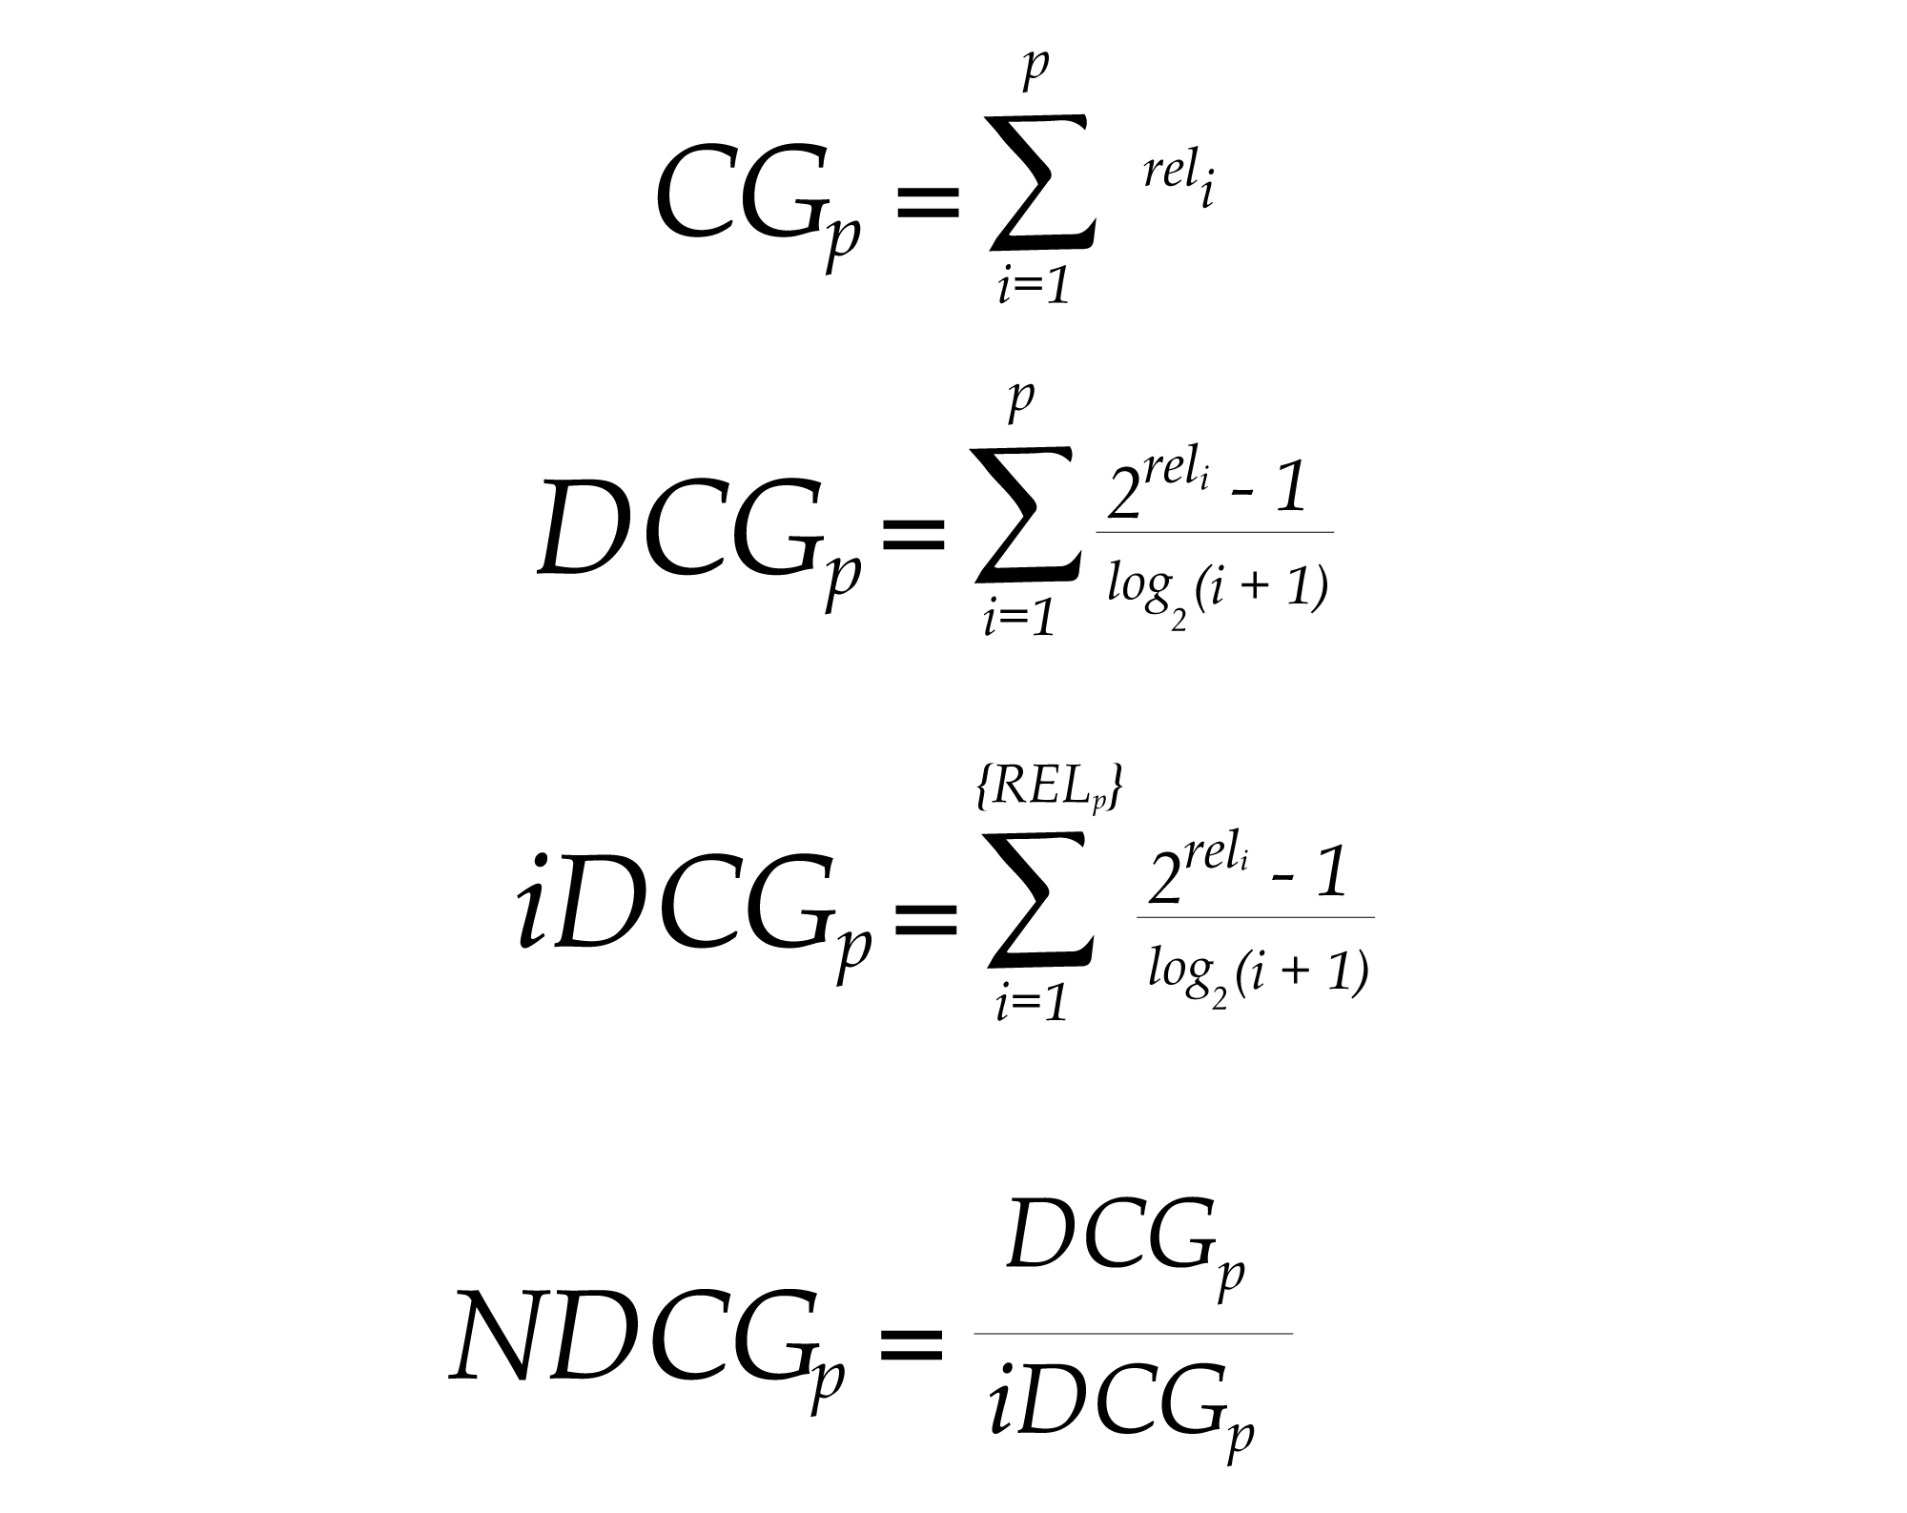
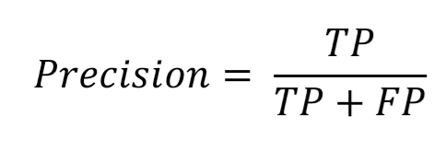
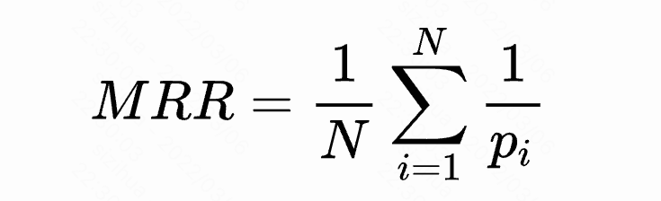
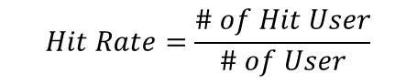
Part 4
Metrics
Recall
Precision
MRR
NDCG
Hit
Notes:
These are metrics used in the experiments. They are performance indicators commonly used in recommendations. Recall is the true positive divided by the sum of true positive and false negative. Precision is the true positive divided by the sum of true positive and false positive. MRR and NDCG are metrics specifically used in recommendations and were used to include the recommendation order in the performance evaluation. If five contents are recommended, even if all five are included in the contents the user has seen, a model that recommends preferred items first is better, so a weighting method is used based on the recommendation order. Hit represents the proportion of users who have at least one hit item among all users.

Slide 41
Part 4
Model evaluation
MODEL | Recall@10 | MRR@10 | NDCG@10 | Precision@10
Pop | 0.0379 | 0.2585 | 0.1008 | 0.0859
BPR | 0.0409 | 0.2745 | 0.1123 | 0.0976
ItemKnn | 0.059 | 0.3811 | 0.1655 | 0.1404
NeuMF | 0.0408 | 0.2598 | 0.1073 | 0.0951
MultVAE | 0.0524 | 0.3204 | 0.1379 | 0.1199
Notes:
Here's the performance of the models. Although the parameter tuning has not been carried out properly, it can be seen that the itemKnn has the best performance so far.

Slide 42
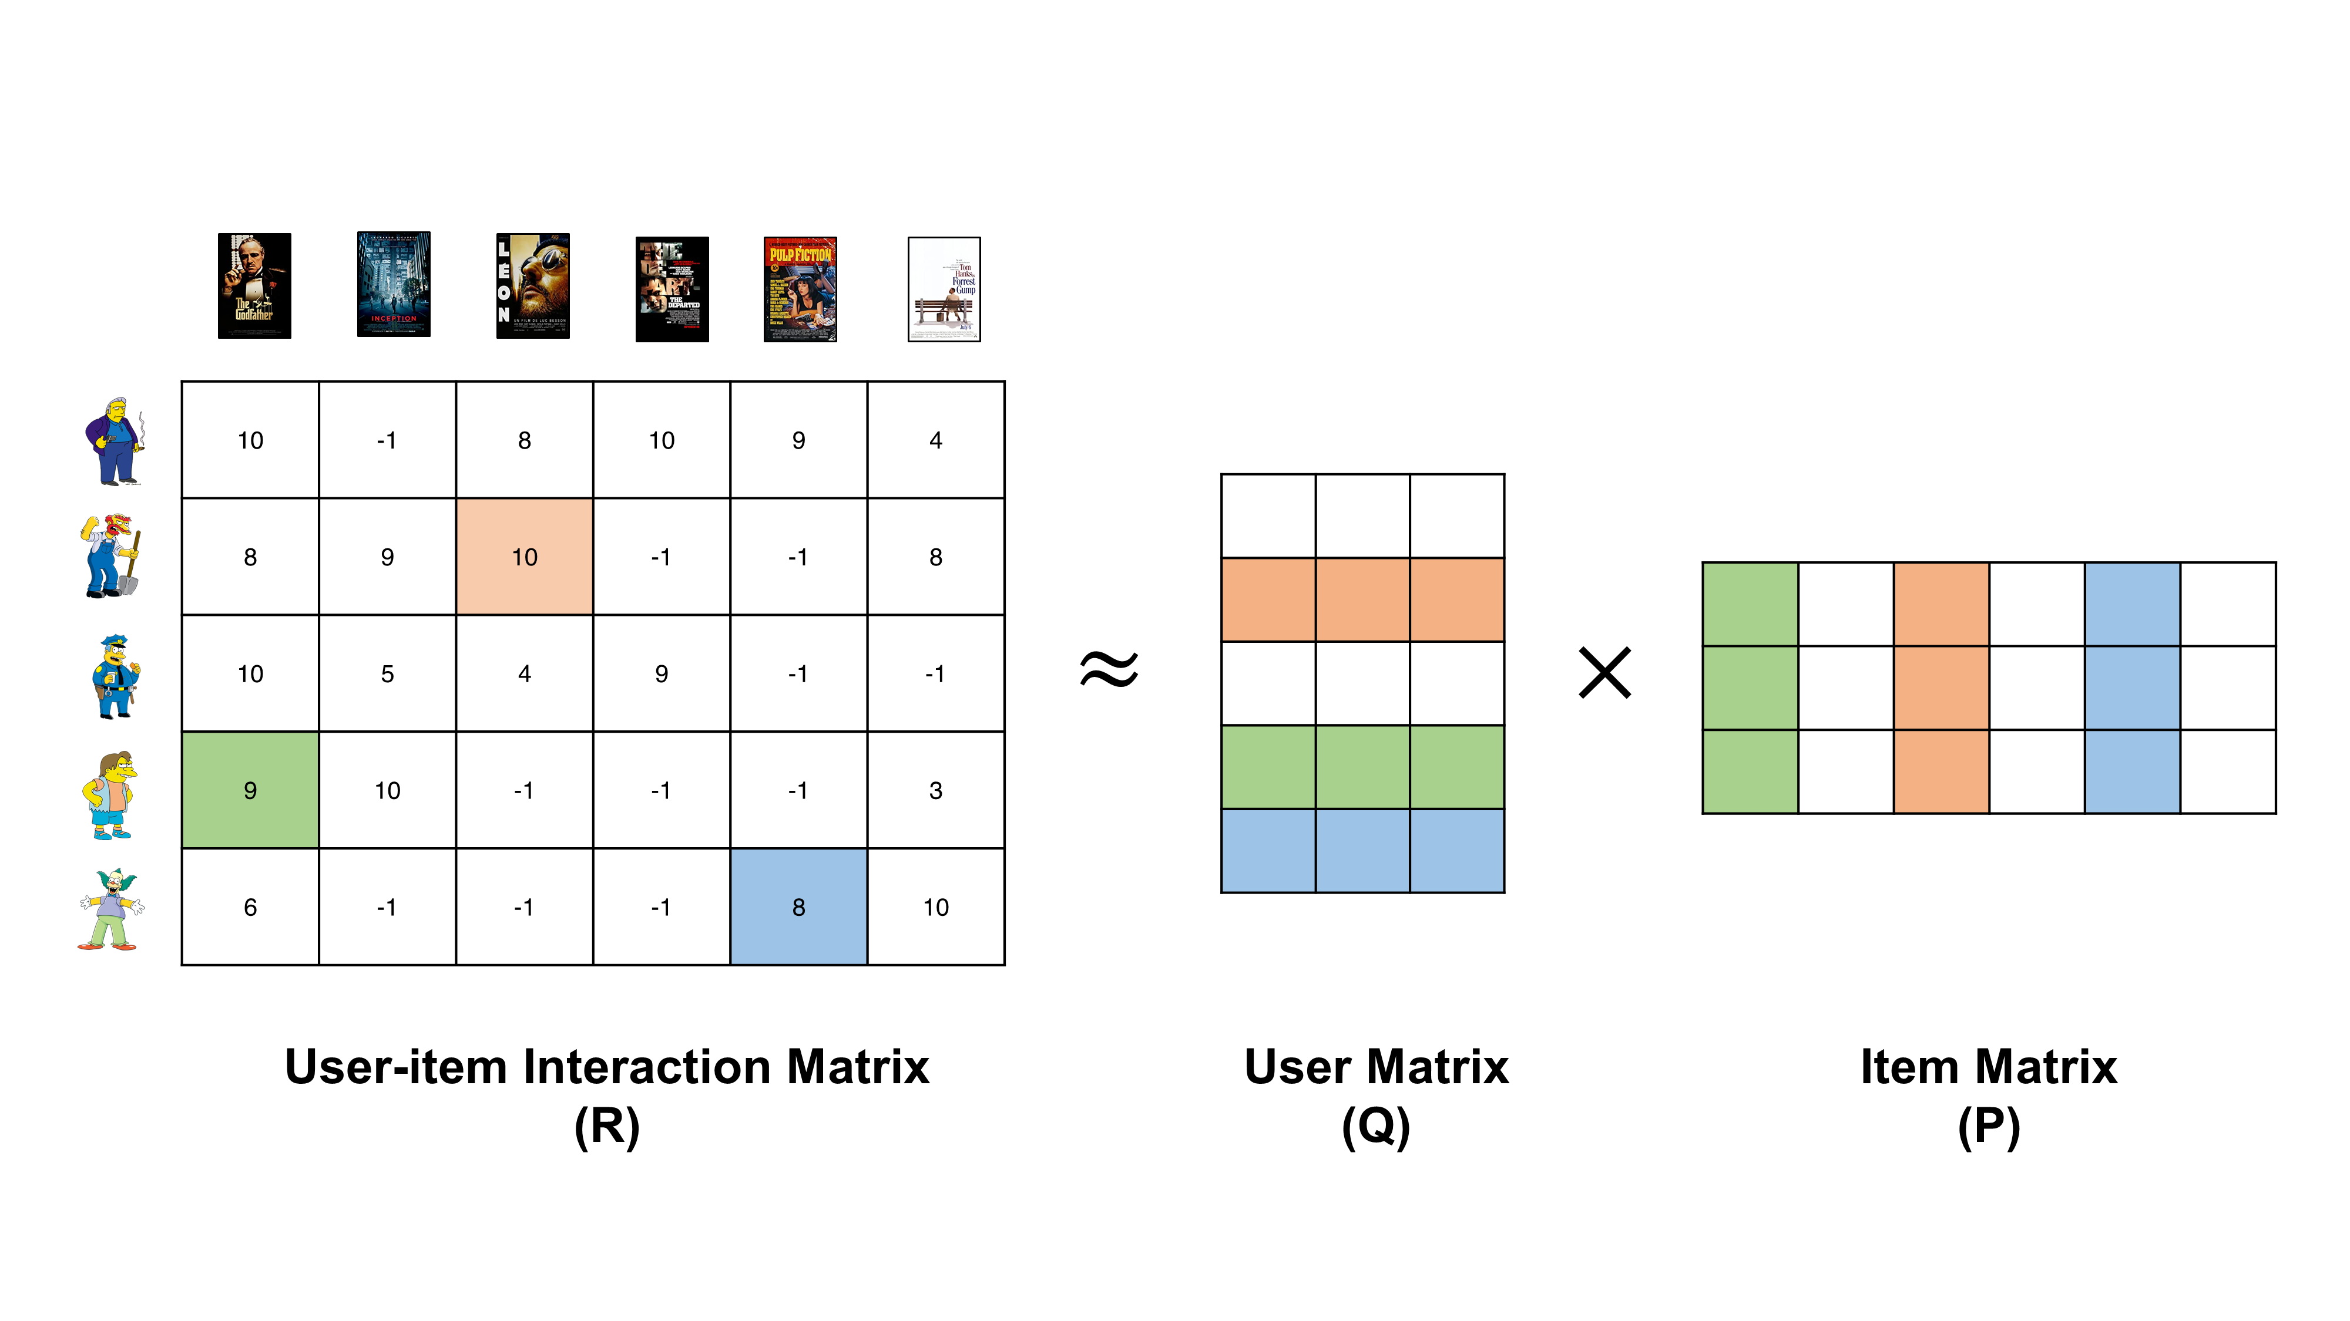
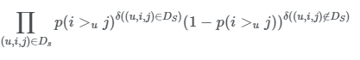
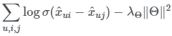
Part 2
BPR(MF)
Notes:
I will briefly explain the models because it is difficult to explain them in detail due to the time limit. BPR is a method using matrix decomposition of matrices. It's a model that applies fairwise loss to MF.

Slide 43
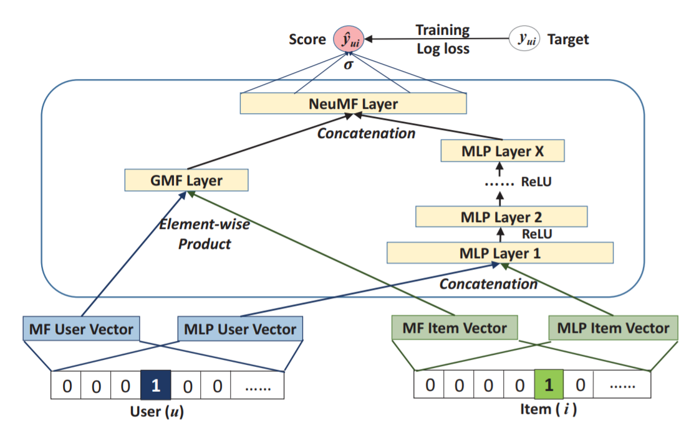
Part 4
NeuMF
Notes:
NeuMF is a model that utilizes both MF and Deep Neural Net at once. It uses a method of converting User and item into embeddings, placing one pair in MF and the other in Multi-layer perceptron to concatenate the final vector.

Slide 44
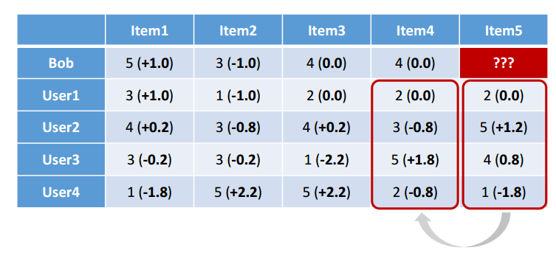
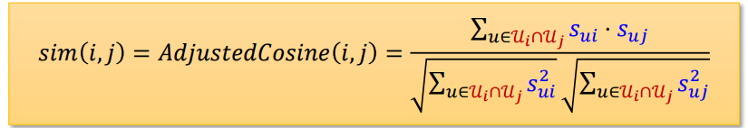
Part 4
Item KNN
Notes:
ItemKNN defines items evaluated similarly by users as similar items and recommends items similar to those seen by users.

Slide 45
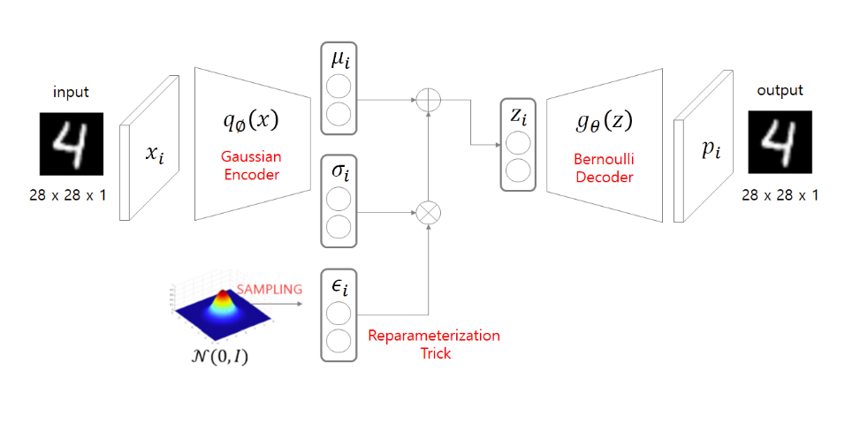
Part 4
MultVAE
Notes:
MultVAE is a generative model with an autoencoder structure. It is a method of learning the embedded vector corresponding to the intermediate stage in the process of learning the input and output values to be the same.

Slide 46

Q&A
ⓒSaebyeol Yu. Saebyeol’s PowerPoint

Slide 47

감사합니다

